Slide 1




Slide 2



Developed By
KRITTIKA
Roll No. 39
ANIMA KUMARI
Roll No. 40
NEHA KUMARI
Roll No. 41

Slide 3
ACKNOWLEDGEMENT
We humbly express our gratitude towards Mr. Sudhir Kumar Singh , MD, Center Head,
Patna Dairy Project, Patna.
Our sincere thanks towards PATNA DAIRY PROJECT, PHULWARISHARIF, PATNA, for giving an opportunity to Develop SOFTWARE which gives us pleasurable experience. With the blessings of God’s grace and Great Teamwork. We was able to satisfactorily complete the project.
We are thankful to Mr.Suresh Kumar MIS Head for his Guidance, Supervision and Posing the Confidence in us and assigning the work to Develop the Project.
We are also thankful to our Respected Principal Dr. Sister Marie Jessie A.c. & Mrs. Manisha Prasad, HOD (BCA) and other faculty members for their consistent guidance and support throughout the Project.
And Of course, A very big Thank you to our Project Guide Mr. Rahul Singh for his Technical Support throughout the project.

Slide 4
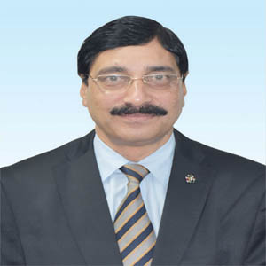
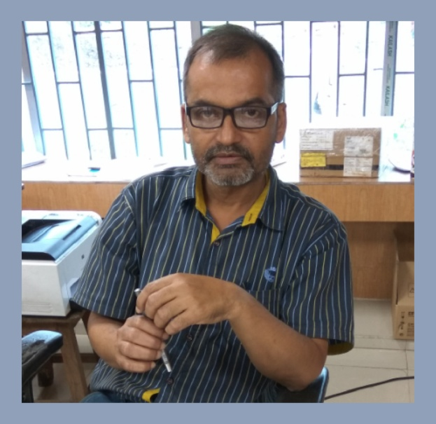

Mr. SUDHIR KUMAR SINGH
MD at Patna Dairy Project
Mr. RAHUL SINGH
Project Guide
&
Technical supporter
Mr. SURESH KUMAR
MIS Head at Patna Dairy Project.
(Our Project Guide)

Slide 5
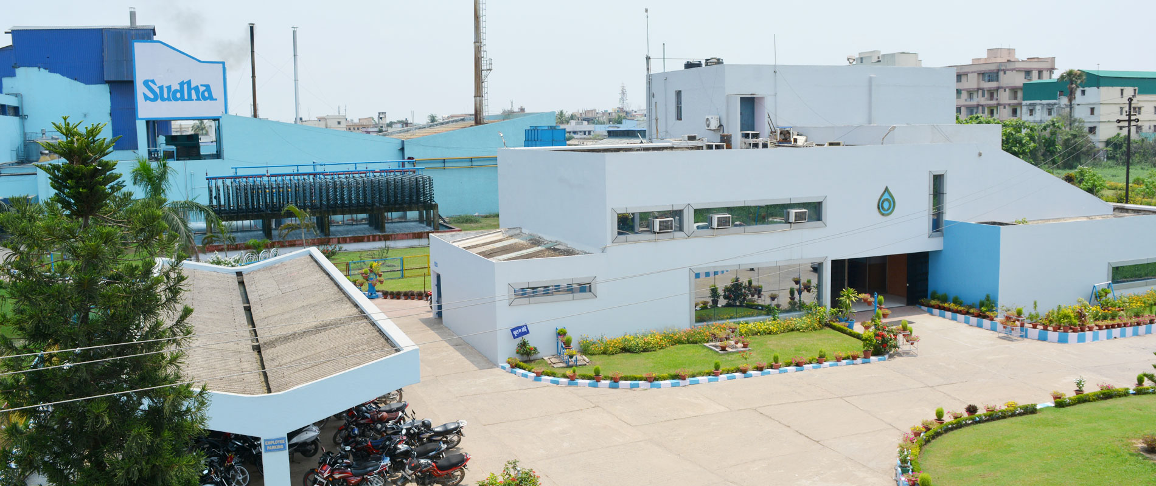
PATNA DAIRY PROJECT
(Name of the Organization)

Slide 6
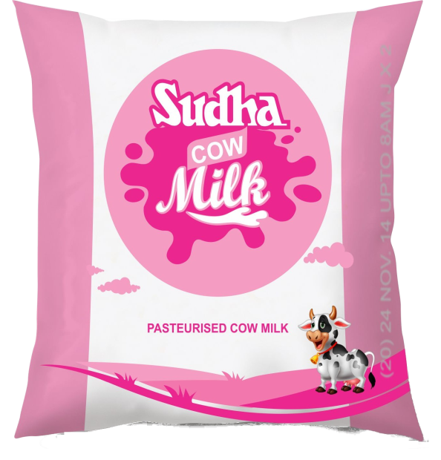
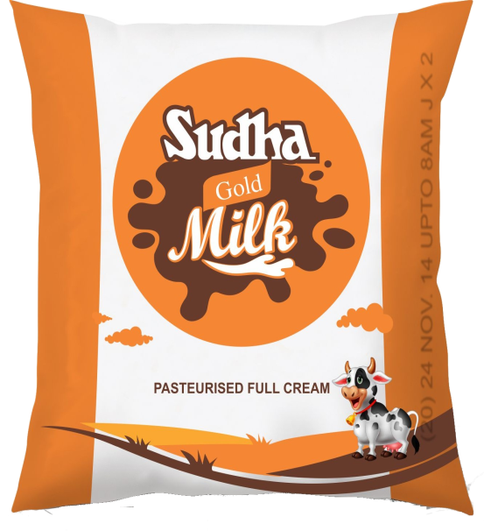
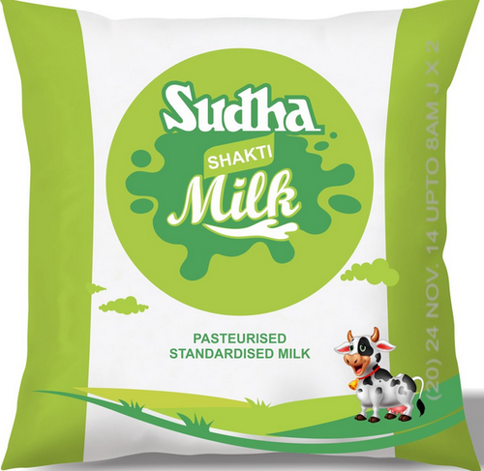
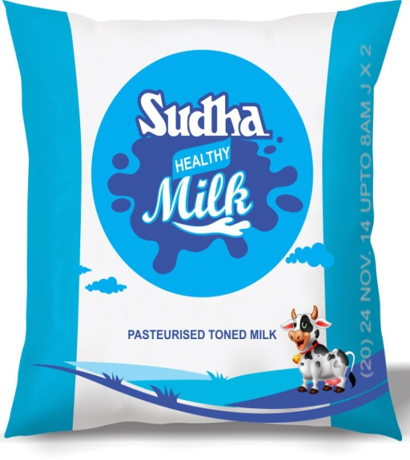
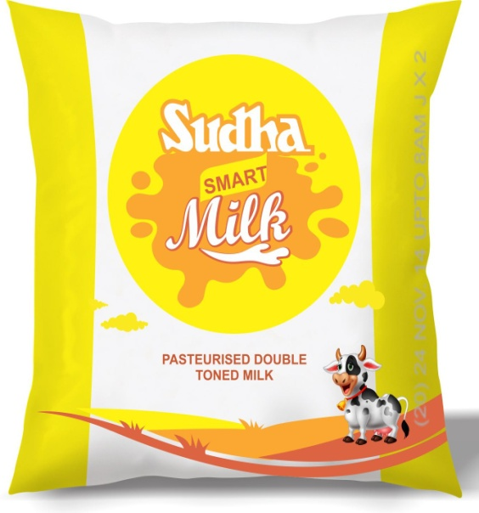
LIQUID MILK MANAGEMENT SYSTEM
(Project Topic)

Slide 7
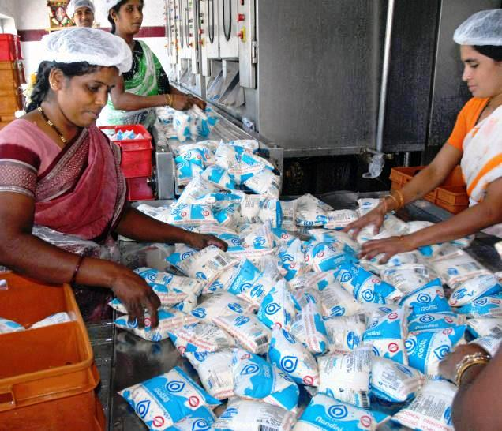
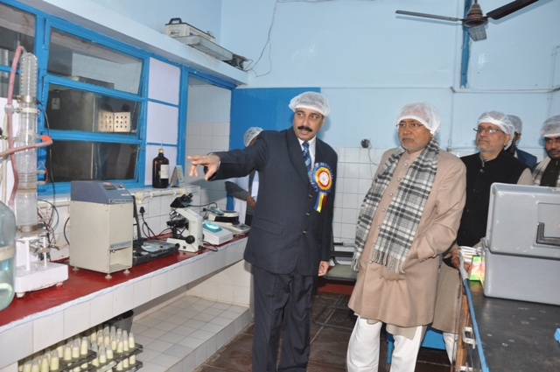
ABOUT
PATNA DAIRY PROJECT

Slide 8
PDP was started at 1st October, 1981 through the National Dairy Development Board (NDDB).
NDDB handed over the arrangements of Patna Dairy Projects (PDP) to Vaishal Patliputra Dugdh Utpadak Sahkari Sangh Ltd. (VPDUSS) with effect from 1st July , 1988.
The company is ISO-9001:2000 and HACCP (IS-15000) certified by Bureau of India standards in March, 2002.
The State Government felt it worthwhile to request the DAIRY BOARD (NDDB) for taking over the infrastructure created on management basis .
The National Dairy Development Board (NDDB) took over the management of the infrastructure with effect of 1st October, 1981 under the banner of Patna Dairy Project (PDP).

Slide 9

About The Project
LIQUID MILK MANAGEMENT SYSTEM

Slide 10
LIQUID MILK MANAGEMENT SYSTEM for PATNA DAIRY PROJECT is basically designed for managing the marketing of Liquid Milk Products of the company .
This system maintains Daily Supply of the milk as per Daily & Monthly Demands of Distributors and Retailers.
It also maintains Main Product Records, Product Records and Distributor Master very strictly as it is necessary to secure and restrict the unauthentic users.
The main work is to generate different Reports and create Backup Files of every shifts on daily basis.
Users who are registered and given username -- password can make entries like Zone Master, Retailer Master and also makes Demand and Supply of the products and generate any Report.

Slide 11



As per the processes defined by the Management Team and our Project Guide Mr. Suresh Kumar Sir .
The organization maintains two types of authorization that is :
ADMINISTRATOR
USER / EMPLOYEE
ADMIN
USER

Slide 12



Slide 13
To make the interface user friendly.
To make the system secure by adding login details.
To acquire knowledge about management practices which will we useful for us in future.
To make the system self sustainable such that the physical work can be avoided.
To enhance the facilities of existing system.
Customer satisfaction and implementation of new technology.
On the whole, the system should be more user friendly than the previous Computerized system.

Slide 14




TOOLS & ENVIRONMENT
OPERATING SYSTEM
Windows
FRONT END
JAVA
BACK END
ORACLE 10g

Slide 15
Existing System
Existing system was outdated and older technology which is not user friendly.
Existing system was Platform Dependent and it is hard to handle, by a non-technical person.
In Existing System there is problem with Data Redundancy which means creation of duplicate data.
Due to limitations of Existing System we proposed a Fully New System.

Slide 16
proposed System
Proposed System is Computerized Desktop Based System and with new technology and user friendly.
All work became so easy after the implementation of Proposed System that each work can be done only by just clicking.
Proposed System is very easy to handle even by a non- technical person.
We introduced a backup of each shift transaction on daily basis, in excel sheet which enhances the readability and it can’t be modified.

Slide 17
ENTITY RELATIONSHIP
DIAGRAM

Slide 18
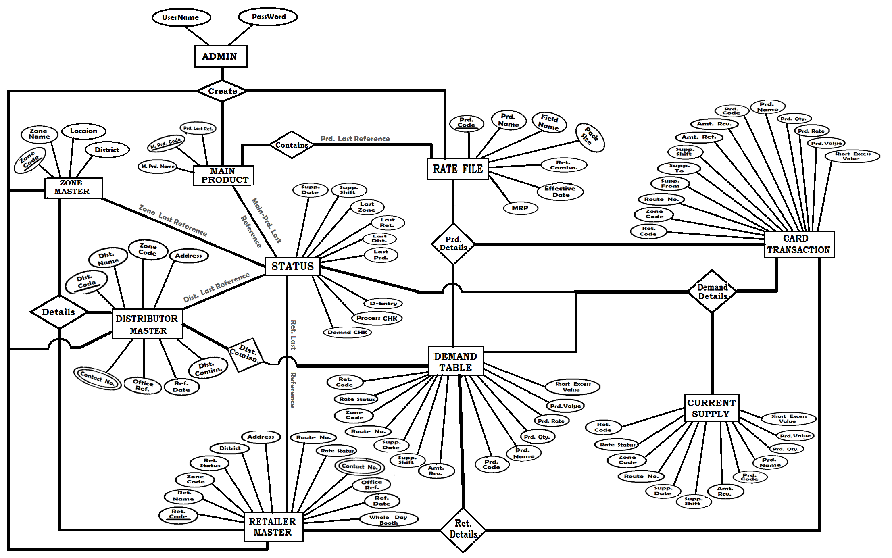

Slide 19
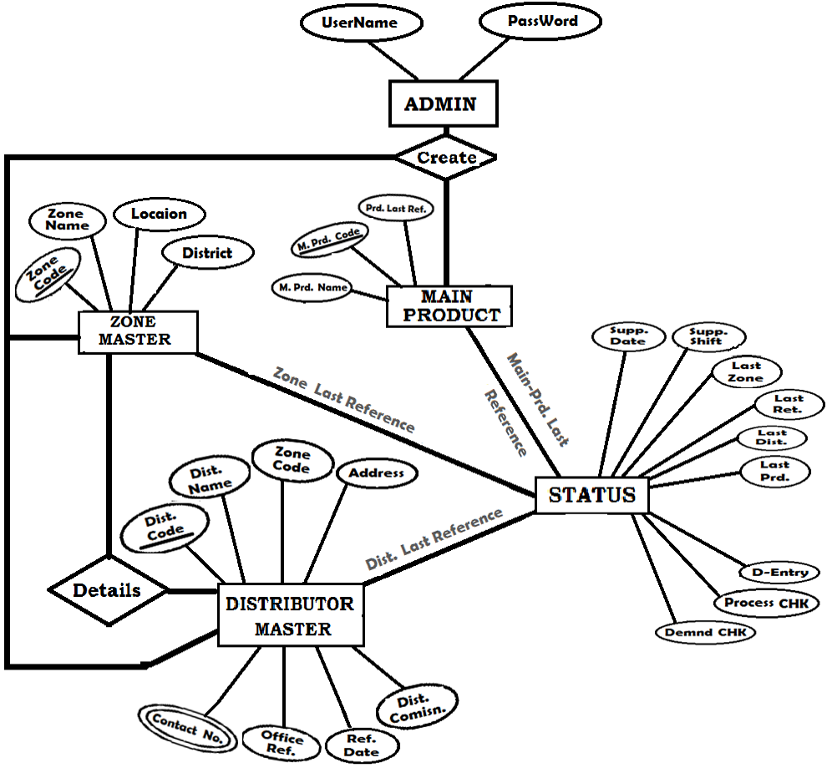
1st Part

Slide 20
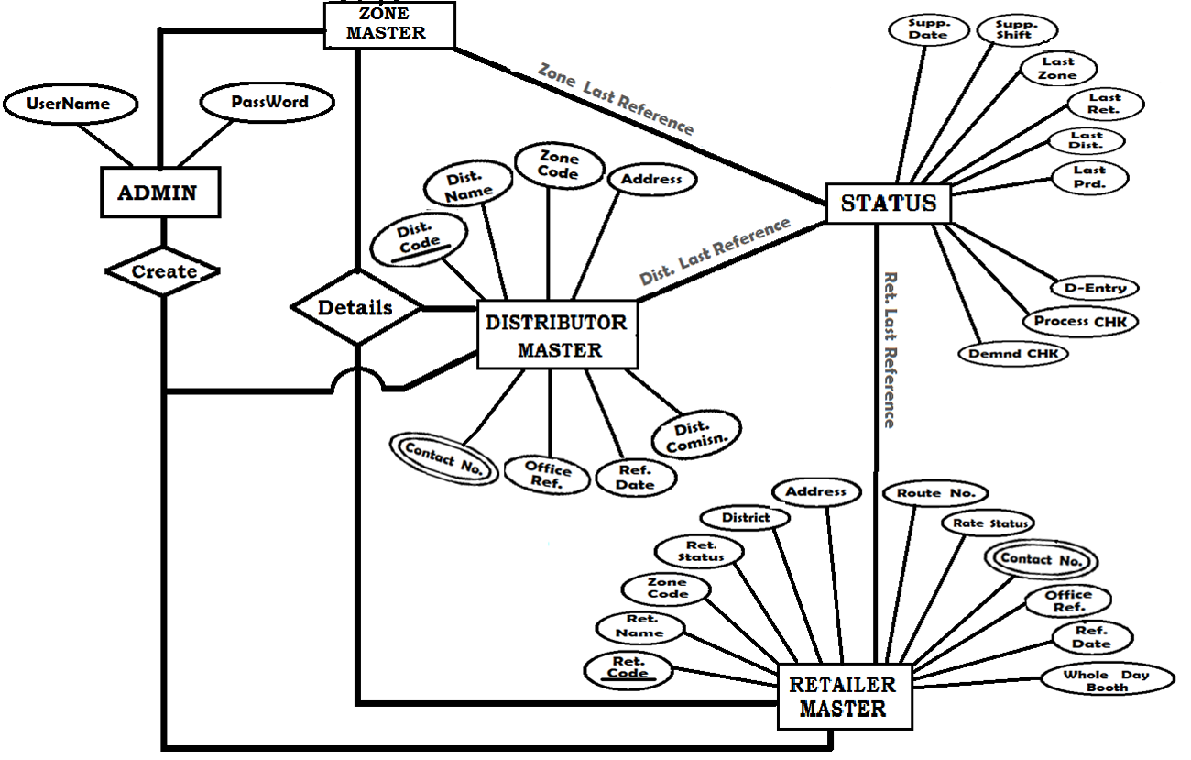
2nd Part

Slide 21
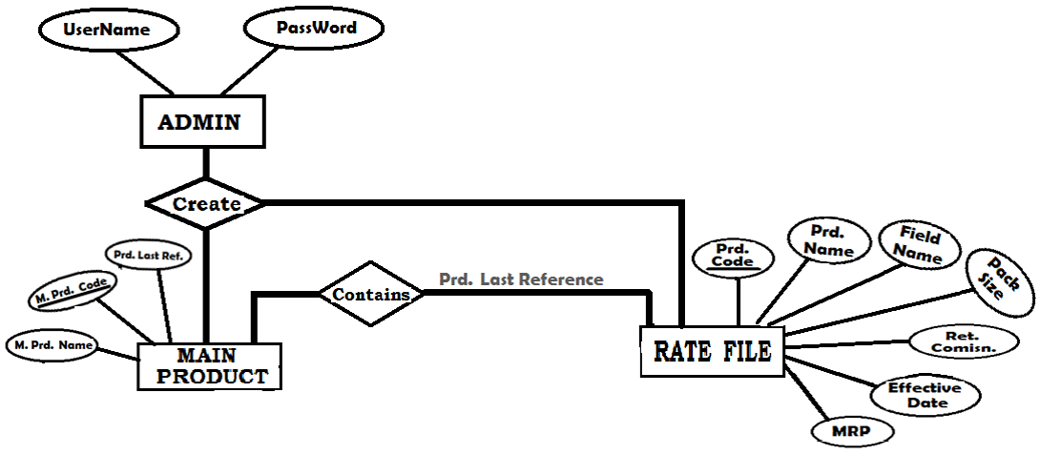
3rd Part

Slide 22
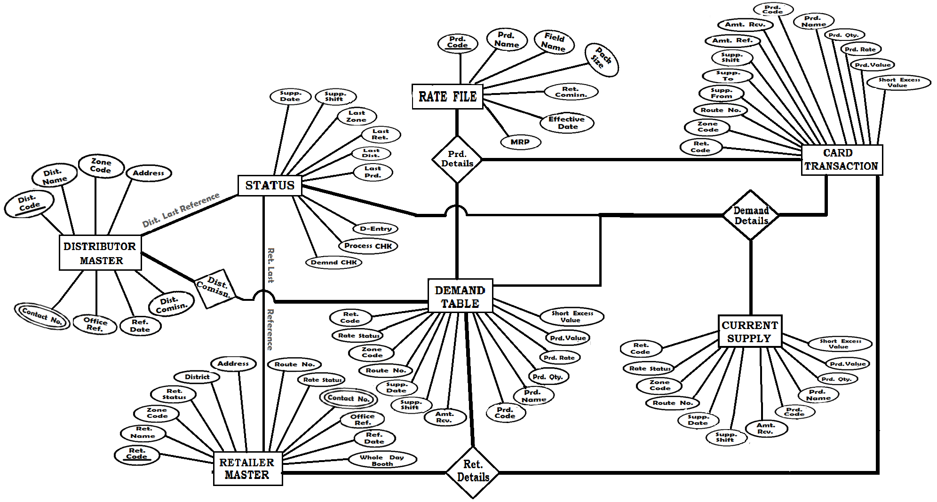
4th Part

Slide 23
DATA FLOW
DIAGRAM
SYMBOLS
ENTITY
PROCESS
FLOW OF DATA
DATA STORE

Slide 24
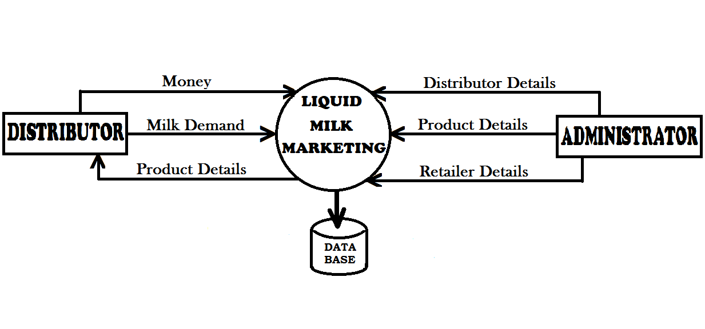
ZERO-LEVEL DFD

Slide 25
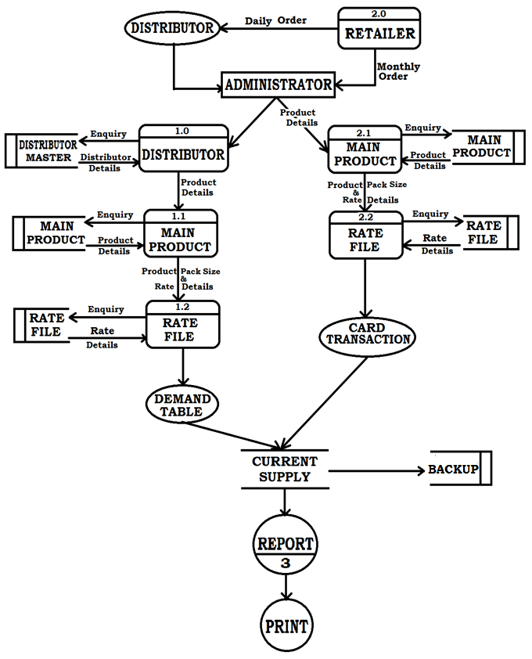
FIRST LEVEL DFD

Slide 26
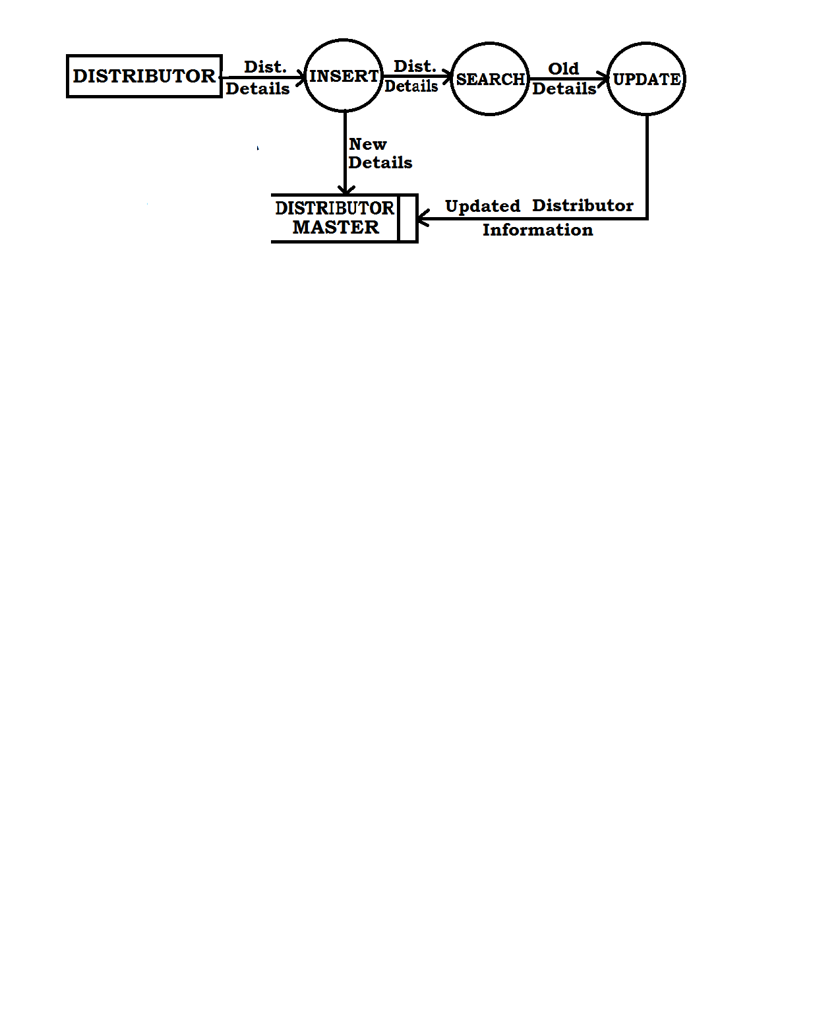
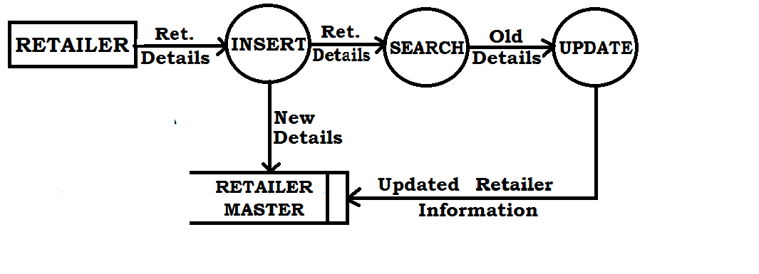
SCEOND LEVEL DFD
Of Distributor
Of Retailer

Slide 27
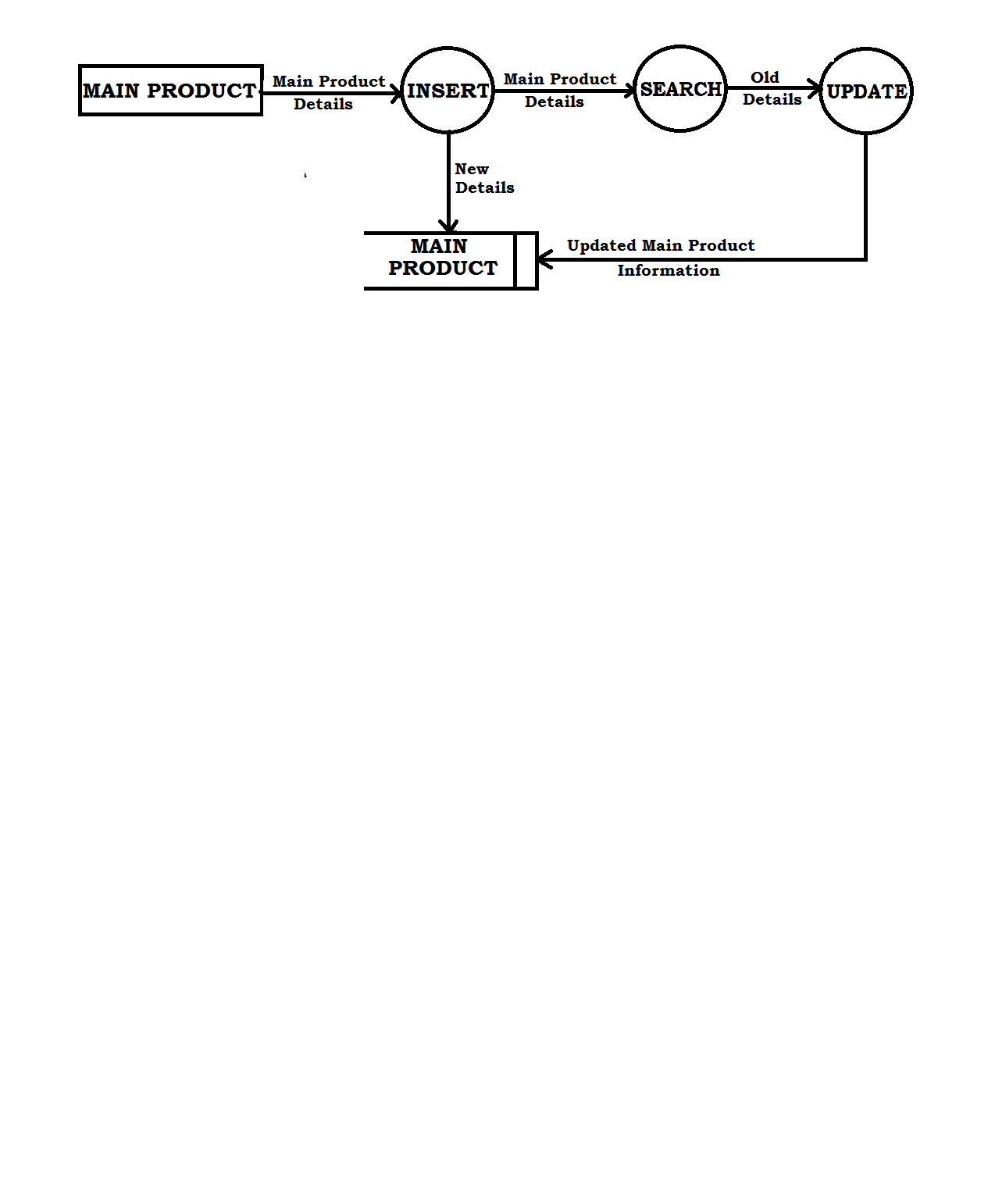
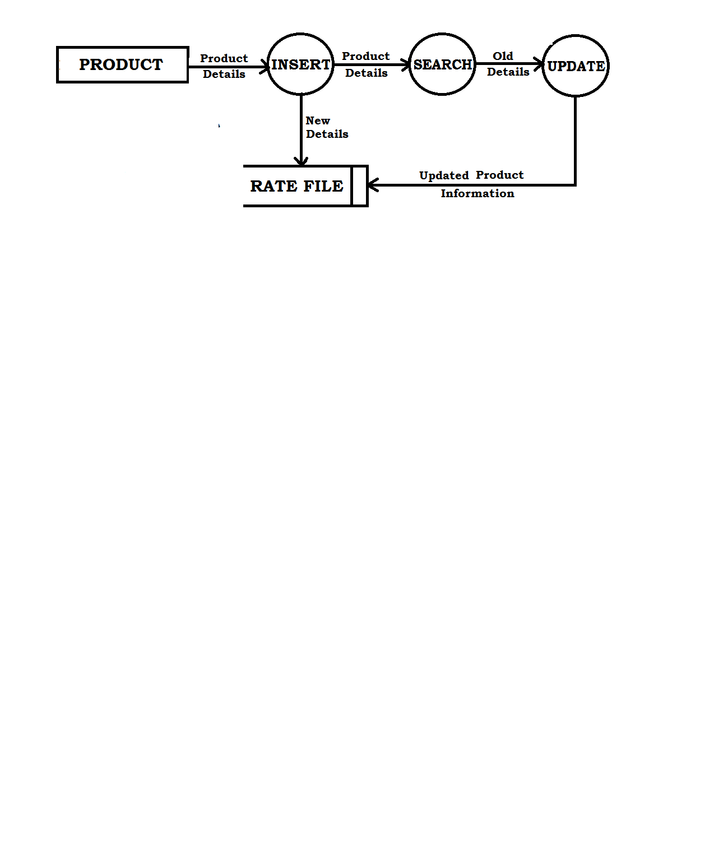
Of Product
SCEOND LEVEL DFD
Of Main Product

Slide 28
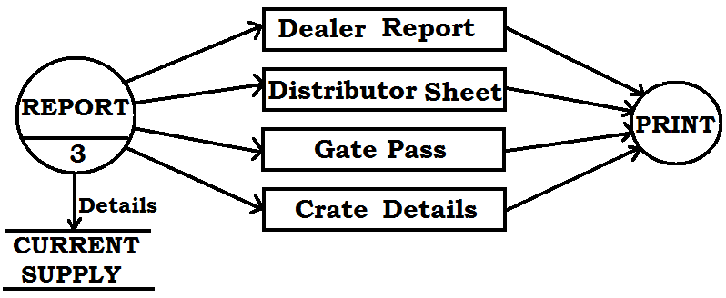
SCEOND LEVEL DFD
Of Report

Slide 29



Slide 30

LIMITATIONS
Just A Desktop Based Application Software.
Our software is designed in window form
i.e. desktop form, that can be run
on the desktop only.
It is referred as Desktop Based Software.
We may not be able to substitute a desktop
application with a web based application.

Slide 31

This project is designed to be used at the PDP at Patna. In future it may require to be connected with all the offices in other part of the state.
In future it may be converted into web based application.

Slide 32

Working On The Project
“LIQUID MILK MANAGEMENT SYSTEM”
A great learning experience
It helped us giving technical as well as interpersonal skills and we can definitely say that this period will always act as a stepping stone in our career as software professional.

Slide 33


Slide 34


